Slide 1


Hybrid ML for AML Detection
Modern anti-money laundering (AML) systems face a critical challenge: detecting both known fraud patterns and emerging threats. Traditional supervised models excel at identifying familiar patterns but struggle with novel attack vectors.
Supervised Learning
Unsupervised Detection
Achieves 87% accuracy on known patterns but misses 75% of actual fraud cases due to class imbalance and limited training examples.
Catches 62.5% of fraud by identifying anomalies in transaction behavior—critical for detecting previously unseen laundering techniques.
Hybrid Approach
Combines both methods to create a multi-layered defense system, balancing precision with the ability to detect unknown threats in production environments.
Notes:
1

Slide 2
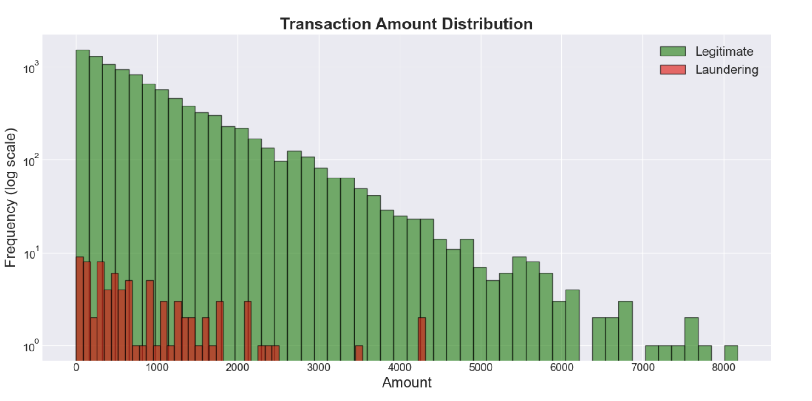
Dataset
Transaction Dataset Overview
Our research utilized a real-world financial dataset comprising 10,000 transactions with only 81 confirmed money laundering cases (0.81%) representing the extreme class imbalance typical in AML detection.
Core Features
Transaction amount and payment type
Currency and cross-border indicators
Bank location and account metadata
Feature Engineering
Data Split Strategy: 80-20 train-test split with SMOTE applied exclusively to training data to prevent test set contamination and maintain realistic evaluation conditions.
Time-based patterns (velocity, frequency)
Financial risk indicators (amount anomalies)
Behavioral aggregations
Notes:
2

Slide 3



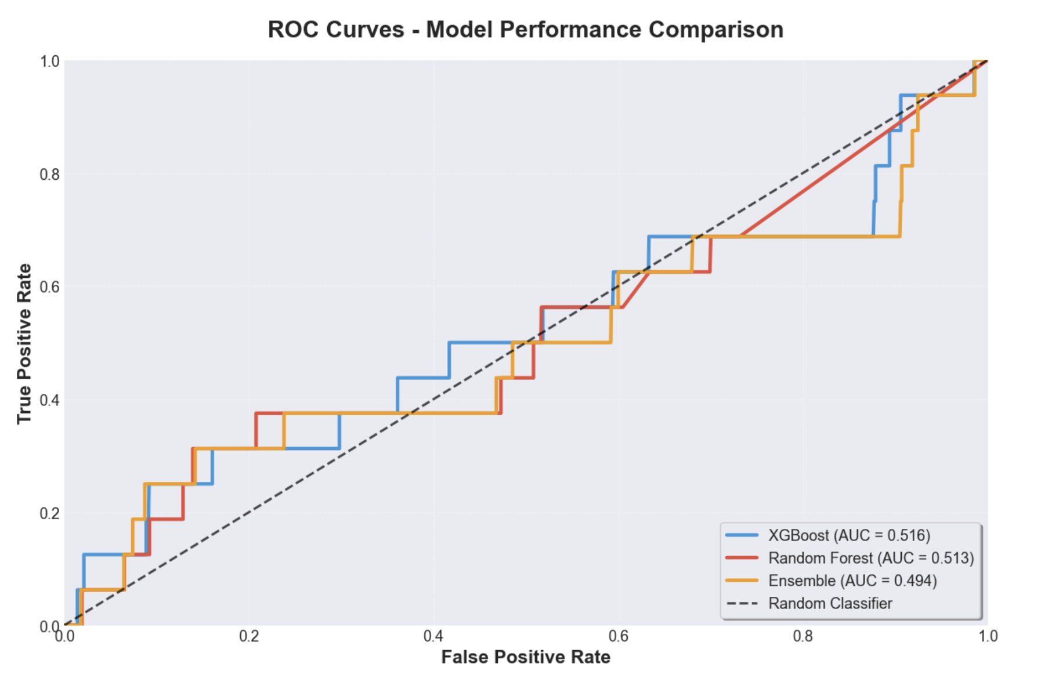
Methods: Supervised + Unsupervised
We implemented a comprehensive hybrid approach combining multiple machine learning techniques to maximize fraud detection while maintaining operational feasibility.
XGBoost
Random Forest
Ensemble Voting
Gradient boosting with 200 trees and maximum depth of 6, optimized for handling imbalanced classes through scale_pos_weight tuning.
Ensemble of 200 decision trees with depth 15, providing robust predictions through bootstrap aggregation and feature randomization.
Soft voting classifier combining XGBoost and Random Forest predictions to leverage complementary strengths and reduce individual model bias.
Unsupervised Detection
Isolation Forest
Trained on legitimate transactions only with 100 estimators. Isolates anomalies by measuring path length in random decision trees—shorter paths indicate unusual patterns that may represent novel money laundering schemes.
Notes:
3

Slide 4
Evaluation Results
Best Performing Model: Ensemble Voting
87.0%
0.029
25%
Accuracy
F1-Score
Recall
Overall classification correctness across all transactions
Percentage of actual fraud cases successfully detected
Key Insights
Isolation Forest Performance
The supervised ensemble achieves high accuracy but struggles with recall due to extreme class imbalance—a common challenge in AML systems where false negatives carry significant risk.
62.5% recall demonstrates superior fraud detection capability, catching more than double the cases identified by supervised methods, though with increased false positive rates requiring human review.
The hybrid approach bridges the gap between precision-focused supervised learning and comprehensive anomaly detection, providing defense-in-depth for financial institutions.
Notes:
4

Slide 5




Team Contributions
This research represents a collaborative effort combining expertise across machine learning, data engineering, and financial analytics to deliver a production-ready AML detection system.
Khushboo Kumari
Harshit Mahori
XGBOOST And Random Forest
Ensemble Voting, Isolation forest and Performance metrics
Gaurang Kumbhar
Arin Lale
EDA And Model Evaluation
Anomaly Detection, Evaluation & Visualisation
Notes:
5

